Slide 1
Including Children with Visual Impairments or Deafblindness into Physical Education: A Universal Design Approach
Dr. Lauren J. Lieberman
Kristi Lane
Rachel Sherman
The College at Brockport
Beth Foster
California Poly Pomona

Slide 2
Overview of presentation
1) Review of VI conditions and what they can see
2) Etiquette when you are around people with VI
3) Eligibility and Placement in PE
Break
4) Instructional approaches-pre-teaching, whole-part-whole, physical guidance, tactile modeling, coactive movement, utilizing paraeducators
5) ECC and how to meet all components (provide a copy of your ECC article, I have an activity to do for this with their table mates)
Break
6) Sport opportunities and Camp Abilities
7) APH products and adapted equipment
8) More resources-books, web sites, programs, etc.
9) questions

Slide 3
"Lack of sight, does not mean
lack of vision."
Tim Willis - Top world athlete USABA, 1998

Slide 4
Definition of Visual Impairment
Visual impairment, including blindness, means:
an impairment in vision that, even when corrected, adversely affects a child’s educational performance.
the term includes both partial sight and blindness.
(PL 105-17, Individuals with Disabilities Education Act, 2004)

Slide 5
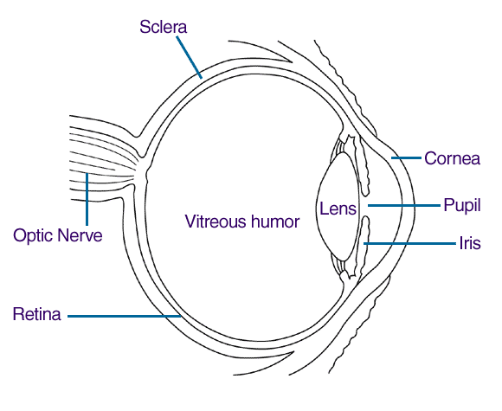
Diagram of the EYE
Macula

Slide 6
Causes of Vision Loss
Albinism lack of pigment, nystagmus
Cortical Visual Impairment intermittent vision
Retinal Blastoma cancer of the eye.
Macular Degeneration (Stargardts disease) loss of acuity & blind spot in middle of vision
Retinitis Pigmentosa progressive, cell lose (rods & cones, night blindness, peripheral vision loss. (inherited)
Lebers Congenital Amaurosis nystagmus, and severe vision loss or blindness
Glaucoma intraocular fluid, damage to optic nerve
Retinitis of Prematurity occurs in some infants that are born prematurely

Slide 7
Vision issues
Acuity issues
Field loss
Distance issues
Close up issues
Hemiopia loss
Blindness
www.acbvi.org/albums/Vision/index.html

Slide 8
Introduction Activity
Engage our brains and activate our body
One, Two, Three
Circle meet and greet

Slide 9
This site has a vision simulator & information regarding vision impairment. http://www.visionsimulator.com/ This site is interactive and gives specific information http://www.yorku.ca/eye/eye1.htm
RESOURCE

Slide 11
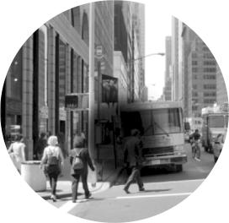
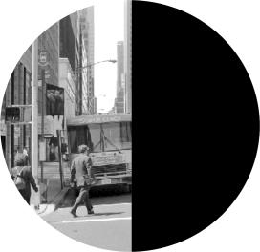
Macular Degeneration
The deterioration of the macula, the central area of the retina, is the most prevalent eye disease.
Hemianopia
Damage to the optic pathways in the brain, can cause vision loss in half of the field.

Slide 12
Macular Degeneration - The deterioration of the macula, the central area of the retina, is the most prevalent eye disease. This picture shows the area of decreased central vision called a central scotoma. The peripheral or side vision remains unaffected so mobility need not be impaired.

Slide 13
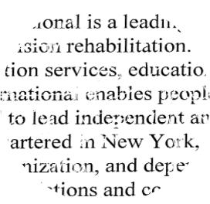
With macular degeneration, print appears distorted
and segments of words may be missing.

Slide 14
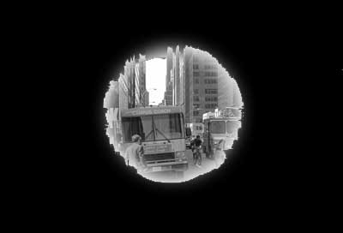
Retinitis Pigmentosa
Congenital degeneration of the pigmented layer of the retina that leads to a severe loss of peripheral vision. Even though central vision may remain clear, traveling is difficult because of side vision loss.

Slide 15
Glaucoma
Damage to the optic nerve caused by high eye pressure.
Optic nerve sends messages about what we see from the eye to the brain.
If not treated, damage increases, causing a loss of peripheral (side) vision. Without treatment, may eventually lead to blindness.

Slide 16
Etiquette with Individuals with Vision Loss
Say your name
Ask if they would like assistance first
Say who is in the room
Say when you are leaving
Explain social situations (laughing, loud noise, etc.)
Doors opening, steps, etc.
**On a team or in class conduct Disability Awareness activities-guided by the student with VI

Slide 17
ACTIVITY TIME
Review of proper human guide!

Slide 18
I Feel Included When
https://www.youtube.com/watch?v=qZfjrd-B0ho

Slide 19
Evaluations/Assessments
Most important part of ensuring each student receives the most appropriate physical education program
The program must be in the student’s least restrictive environment

Slide 20
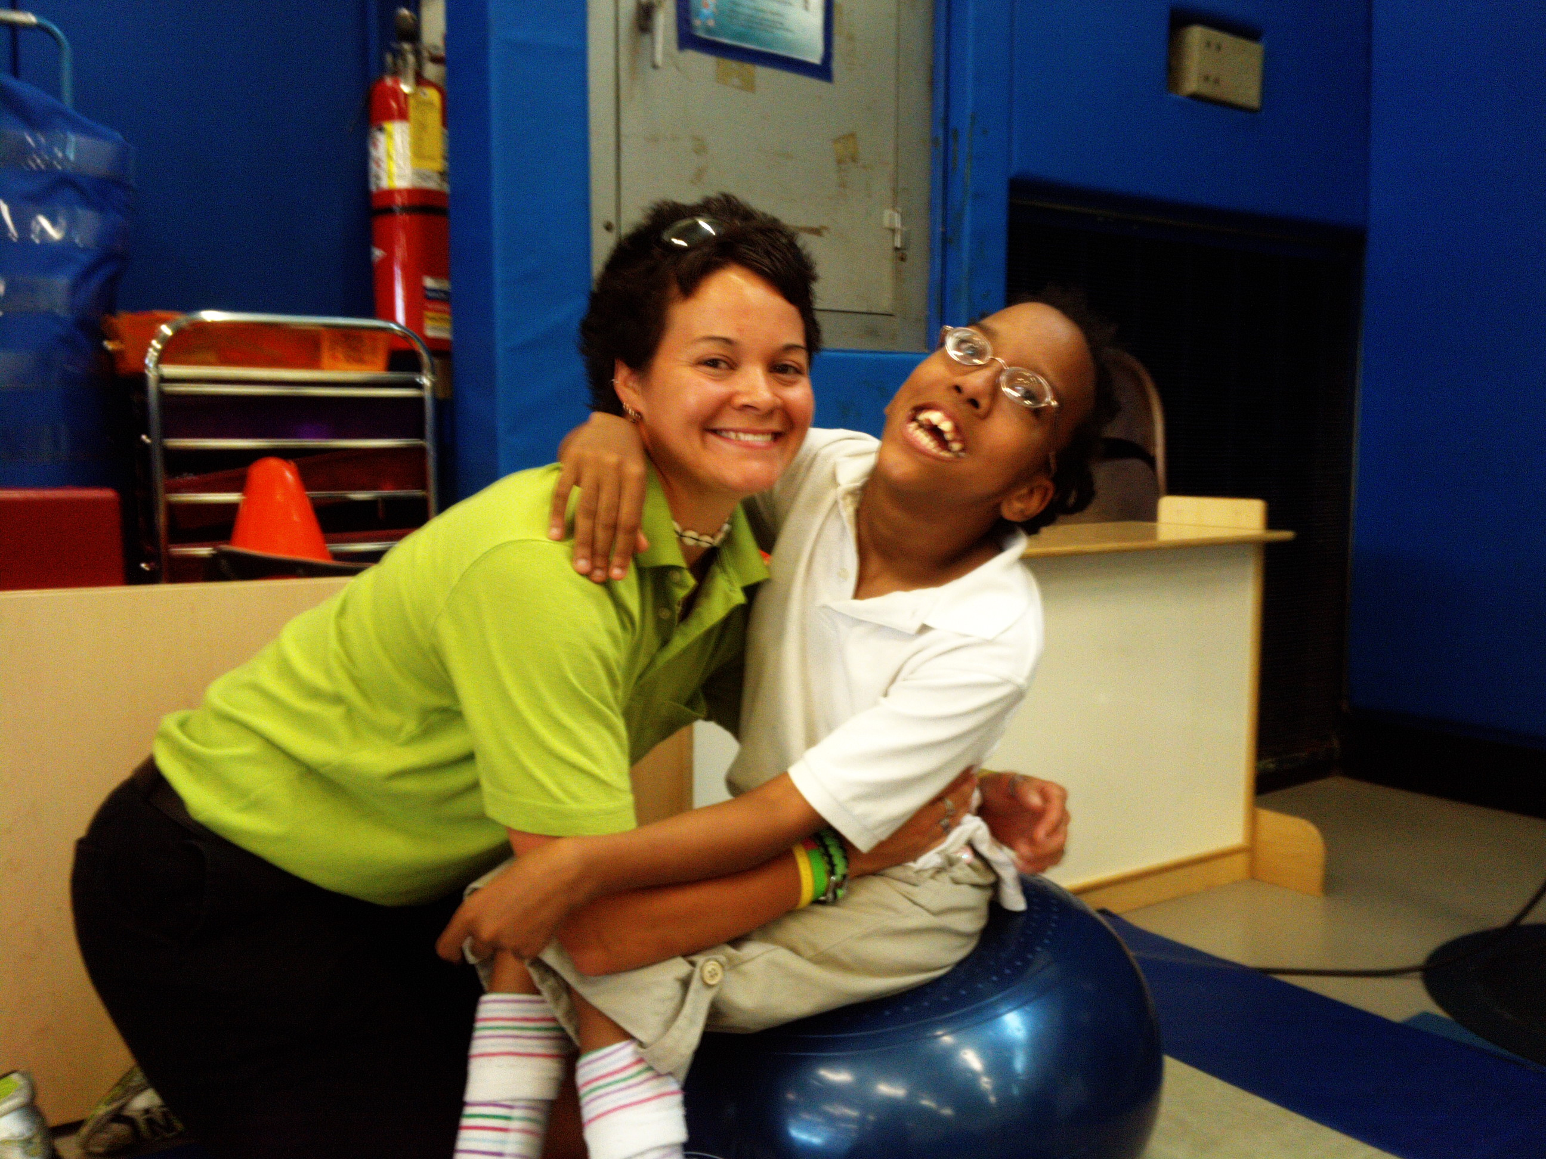
PLACEMENT
Process
Safe and Successful
Screening
Referral
Eligibility
Placement options
Before we can ask for any Performance the Physical Education Environment MUST be safe for the student

Slide 21
Placement in APE
Inclusive PE
Modified class
Self contained class
Combination
Supports in each
Peer tutors
Paraeducators
Intervenors (Deafblind)

Slide 22
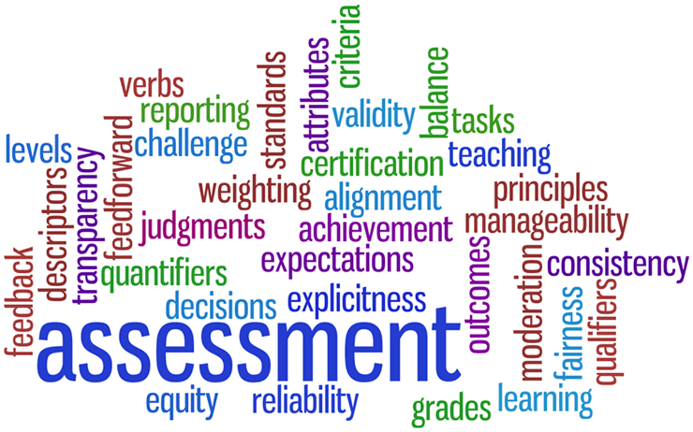
Assessments
Motor skills: Test of Gross Motor Development III
Health Related Fitness: Brockport Physical Fitness Test
Talking Pedometers
Camp Abilities Assessment checklist

Slide 23
Test of Gross Motor Development II (III)
Validated ages 3-10 (able bodied) 6-12 (children with VI)
Object Control
Locomotor
Norm referenced
Pro-Ed Publishers

Slide 24
Brockport Physical Fitness Test Target Populations
VISUAL IMPAIRMENTS
INTELLECTUAL DISABILITIES
CEREBRAL PALSY
SPINAL CORD INJURY
CONGENITAL ANOMALY/AMPUTATIONS

Slide 25
Instructional Strategies
Pre-teaching
Whole-Part-Whole
Tactile Modeling
Physical Guidance
Coactive movement
Guide running techniques
Guide wire
Tether
Human Guide
Independently
Treadmill

Slide 26
Pre-Teaching
Instruction that occurs prior to the start of the unit or sport season
Reviews equipment, activity layout (playing areas), rules, strategies, teaching cues

Slide 27
Details of Pre-Teaching
Must occur before a unit of instruction
Must include dimensions of the court, equipment, terminology, scoring, levels of competition
Can be conducted by parents (at home), paraeducator, PE, APE teacher, COMS, TVI, peer or a sibling if appropriate
Must be guided by the PE teacher and must be delivered age appropriately

Slide 28
Motor skills must focus on Improvement Not Just participation
Whole
Part
Whole

Slide 29
Tactile Modeling
Student feels teacher or peer going through movement

Slide 30
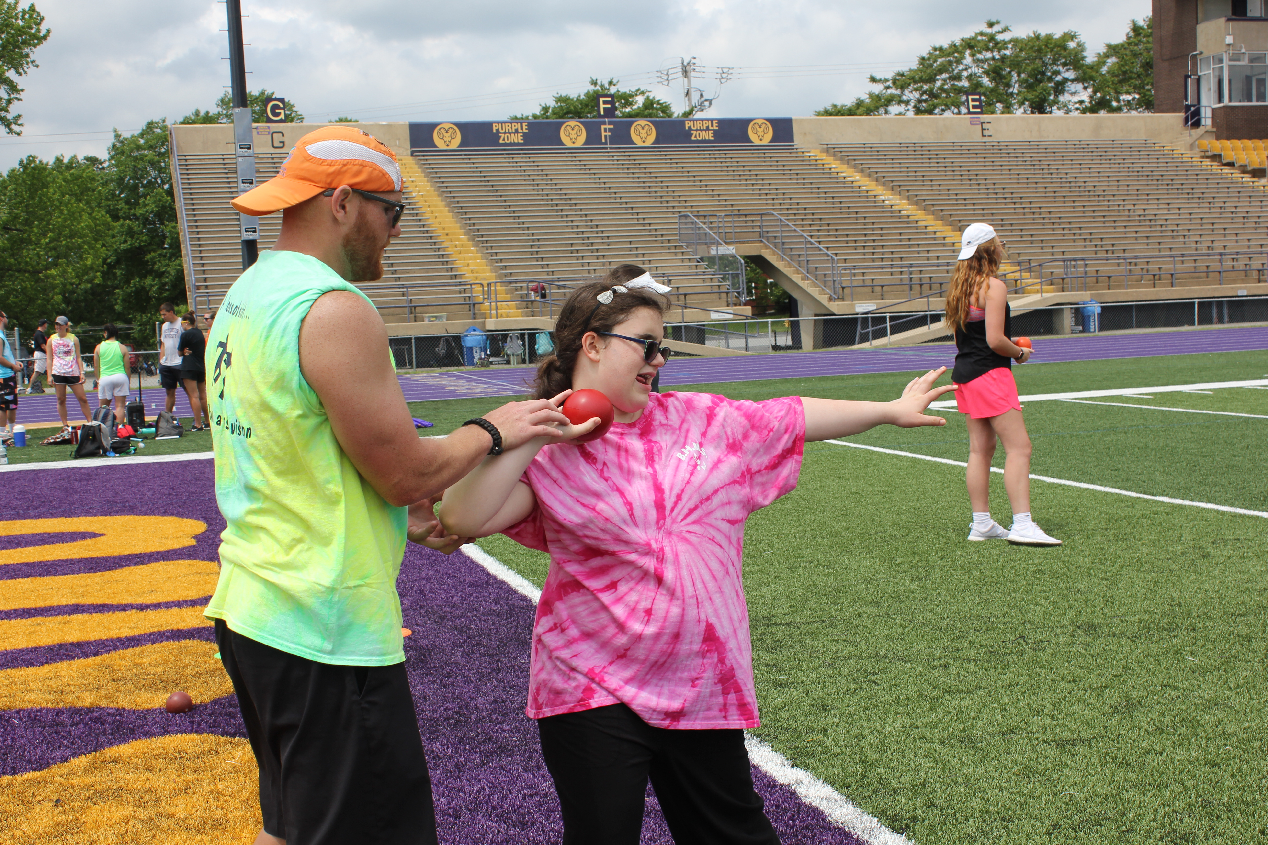
Physical Guidance
Teacher or peer tutor moves student through motion
Hand under hand

Slide 31
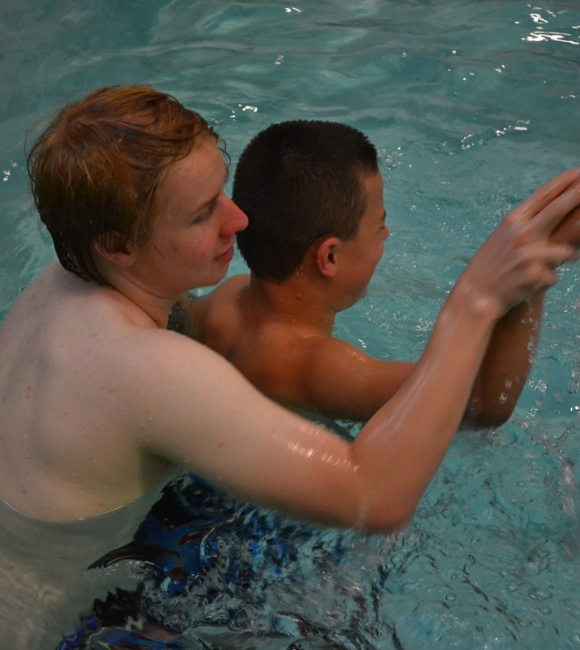
Co-active Movement
Teacher and student move through movement together

Slide 32
Guide-running
Guide running techniques
Guide wire
Tether
Human Guide
Independently
Treadmill

Slide 33
Cross Country Running Video
www.Brockport.edu
Instructional Materials

Slide 34
ACTIVITY TIME
Review Activities in Gym!

Slide 35
We ALL Link Together
Need to share knowledge
Collaborate with each other
Train the Paraeducators and peer tutors

Slide 36
Core Curriculum
The Existing Core Curriculum
English language arts other languages, to the extent possible
Mathematics science
Health and physical education
Fine arts social studies
Economics business education
Vocational education history

Slide 37
Expanded Core Curriculum (ECC)
Compensatory or functional academic skills, including communication modes
Orientation and mobility
Social interaction skills
Independent living skills
Recreation and leisure skills
Career education
Use of assistive technology
Sensory efficiency skills
Self-determination

Slide 38
ECC within Physical Education
Put a Smile :) next to items you are already doing
Put a Star next to items you believe you could implement
Think, Pair, Share: Develop one strategy for a component related to your position

Slide 39
Sports Involvement
Try outs-discuss modifications necessary
Provide equal opportunity for the students with VI with modifications or adaptations if necessary
Adaptations can not change the main objectives of the game
Examples: yellow softball
supporting swimmer on starting blocks
Guide runner in 1500
Caller in the 100
Tape around the volleyball
Call NY State HS Athletic Association and be sure they register your modification
Contact other coaches and referees in the league and let them know ahead of time.

Slide 40
Self-Advocacy
What do you do now for self-advocacy?
What do we do at camp?
How can we continue self-advocacy?

Slide 41
Camp Abilities

Slide 42
Camp Abilities

Slide 43
United States Association for Blind Athletes

Slide 44
Questions

