Slide 1
Including Children with Visual Impairments or Deafblindness into Physical Education: A Universal Design Approach
Dr. Lauren J. Lieberman
Rachel Sherman
Matt Farwell
Jasmine Bradwell
Hannah Williams
The College at Brockport

Slide 2
Lauren Lieberman
llieberman@Brockport.edu
www.Brockport.edu/imsvi

Slide 3
IMSVI
Leadership
Scholarship
Program Development/
Service Learning
Education/
Student Engagement

Slide 4
Disconnect
Physical Education Professional Preparation
Teacher of the Visually Impaired Professional Preparation

Slide 5
Marla Runyan Olympian 2000,2004
Marla Runyan after a race with her arms up in victory

Slide 6
Paralympics 2016: Abdellatif Baka (Algeria) Tamiru Demisse (Ethiopia) Henry Kirwa (Kenya) Fouad Baka (Algeria) 1500m runners finish faster than Rio Olympics gold medal winning time
Runners racing in the 1500 in the Paralympics

Slide 7
Accomplishments
**Dr. Lauren Lieberman awarded a Global Fulbright Scholarship to start Camp Abilities in Ghana, Ireland, and Brazil this upcoming Fall 2019

Slide 8
5-A-Side Soccer

Slide 9
Overview of presentation
1) Review of VI conditions and what they can see
2) Etiquette when you are around people with VI
3) Eligibility and Placement in PE
Break
4) Instructional approaches-pre-teaching, whole-part-whole, physical guidance, tactile modeling, coactive movement, utilizing paraeducators
5) ECC and how to meet all components (provide a copy of your ECC article, I have an activity to do for this with their table mates)
Break
6) Sport opportunities and Camp Abilities
7) APH products and adapted equipment
8) More resources-books, web sites, programs, etc.
9) questions
Notes:
Lauren

Slide 10
"Lack of sight, does not mean
lack of vision."
Tim Willis - Top world athlete USABA, 1998
Notes:
Lauren

Slide 11
Definition of Visual Impairment
Visual impairment, including blindness, means:
an impairment in vision that, even when corrected, adversely affects a child’s educational performance.
the term includes both partial sight and blindness.
(PL 105-17, Individuals with Disabilities Education Act, 2004)
Notes:
Lauren

Slide 12
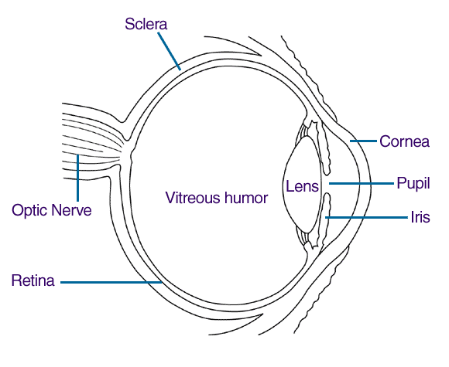
Diagram of the EYE
Macula
Notes:
Lauren

Slide 13
Causes of Vision Loss
Albinism lack of pigment, nystagmus
Cortical Visual Impairment intermittent vision
Retinal Blastoma cancer of the eye.
Macular Degeneration (Stargardts disease) loss of acuity & blind spot in middle of vision
Septo-Optic Dysplasia: is a disorder of early brain development. It can affect growth and development. It affects each child differently. The results of this condition can affect either one or both eyes and the effect on a child’s vision can vary greatly, although most children have a serious visual impairment.
Retinitis Pigmentosa progressive, cell lose (rods & cones, night blindness, peripheral vision loss. (inherited)
Lebers Congenital Amaurosis nystagmus, and severe vision loss or blindness
Glaucoma intraocular fluid, damage to optic nerve
Retinitis of Prematurity occurs in some infants that are born prematurely
Notes:
Matt

Slide 14
Vision issues
Acuity issues
Field loss
Distance issues
Close up issues
Hemianopia loss
Blindness
https://www.myeyedr.com/vision-simulator
Notes:
Matt

Slide 15
Introduction Activity
Engage our brains and activate our body
One, Two, Three
Circle meet and greet
Notes:
Jasmine

Slide 16
Macular Degeneration
The deterioration of the macula, the central area of the retina, is the most prevalent eye disease.
Hemianopia
Damage to the optic pathways in the brain, can cause vision loss in half of the field.
Notes:
Jasmine

Slide 17
Macular Degeneration - The deterioration of the macula, the central area of the retina, is the most prevalent eye disease. This picture shows the area of decreased central vision called a central scotoma. The peripheral or side vision remains unaffected so mobility need not be impaired.
Notes:
Matt

Slide 18
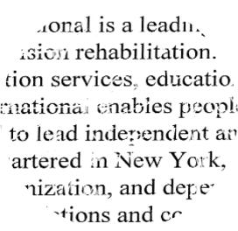
With macular degeneration, print appears distorted
and segments of words may be missing.
Notes:
Matt

Slide 19
Retinitis Pigmentosa
Congenital degeneration of the pigmented layer of the retina that leads to a severe loss of peripheral vision. Even though central vision may remain clear, traveling is difficult because of side vision loss.
Notes:
Lauren

Slide 20
Glaucoma
Damage to the optic nerve caused by high eye pressure.
Optic nerve sends messages about what we see from the eye to the brain.
If not treated, damage increases, causing a loss of peripheral (side) vision. Without treatment, may eventually lead to blindness.
Notes:
Lauren

Slide 21
Cortical Visual Impairment (CVI)
Rising in occurrence of diagnosis
Typically will have a normal visual exam or an eye condition that cannot account for abnormal behavior
What the eye sees is sent to brain but not processed correctly
Typically difficulty ”latching on” to an object or filtering out peripheral stimuli to focus on object
Notes:
Matt

Slide 22
Etiquette with Individuals with Vision Loss
Say your name
Ask if they would like assistance first
Say who is in the room
Say when you are leaving
Explain social situations (laughing, loud noise, etc.)
Doors opening, steps, etc.
**On a team or in class conduct Disability Awareness activities-guided by the student with VI
Notes:
Jasmine

Slide 23
ACTIVITY TIME
Review of proper human guide!
Notes:
Jasmine

Slide 24
I Feel Included When
https://www.youtube.com/watch?v=qZfjrd-B0ho
Notes:
Lauren

Slide 25
Evaluations/Assessments
Most important part of ensuring each student receives the most appropriate physical education program
The program must be in the student’s least restrictive environment
Notes:
Matt

Slide 26
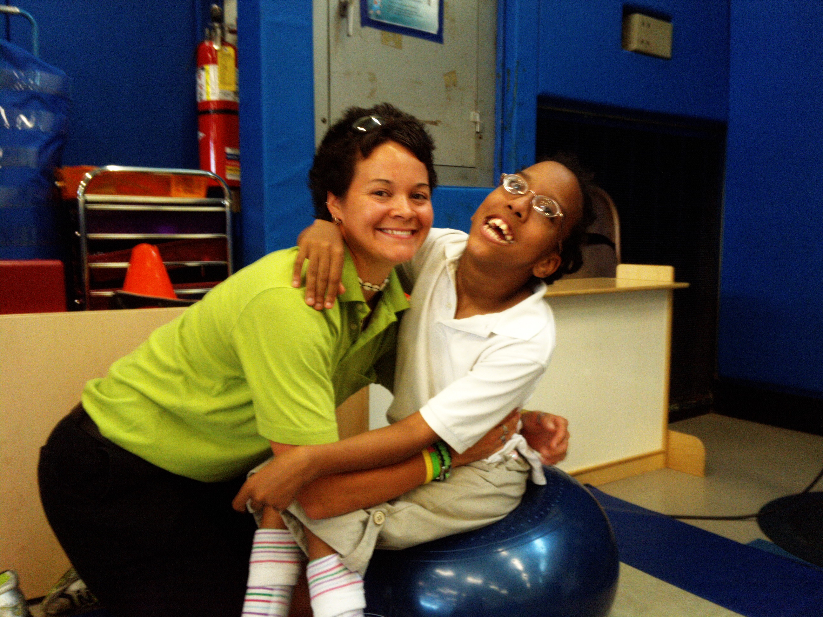
PLACEMENT
Process
Safe and Successful
Screening
Referral
Eligibility
Placement options
Before we can ask for any Performance the Physical Education Environment MUST be safe for the student
Notes:
Matt

Slide 27
Placement in APE
Inclusive PE
Modified class
Self contained class
Combination
Supports in each
Peer tutors
Paraeducators
Intervenors (Deafblind)
Notes:
Matt

Slide 28
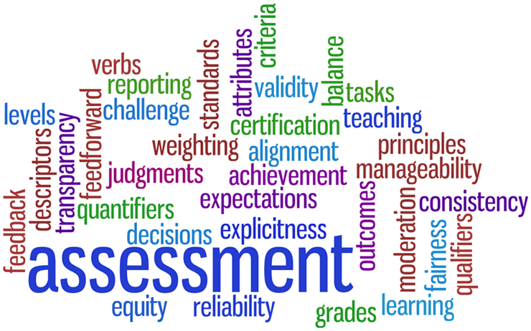
Assessments
Motor skills: Test of Gross Motor Development III
Health Related Fitness: Brockport Physical Fitness Test
Talking Pedometers
Camp Abilities Assessment checklist
Notes:
Lauren

Slide 29
Test of Gross Motor Development II (III)
Validated ages 3-10 (able bodied) 6-12 (children with VI)
Object Control
Locomotor
Norm referenced
Pro-Ed Publishers
Notes:
Lauren

Slide 30
Brockport Physical Fitness Test Target Populations
VISUAL IMPAIRMENTS
INTELLECTUAL DISABILITIES
CEREBRAL PALSY
SPINAL CORD INJURY
CONGENITAL ANOMALY/AMPUTATIONS
Notes:
Lauren

Slide 31
Instructional Strategies
Pre-teaching
Whole-Part-Whole
Tactile Modeling
Physical Guidance
Coactive movement
Guide running techniques
Incidental learning
Blindisms
Notes:
Jasmine

Slide 32
Pre-Teaching
Instruction that occurs prior to the start of the unit or sport season
Reviews equipment, activity layout (playing areas), rules, strategies, teaching cues
Notes:
Jasmine

Slide 33
Details of Pre-Teaching
Must occur before a unit of instruction
Must include dimensions of the court, equipment, terminology, scoring, levels of competition
Can be conducted by parents (at home), paraeducator, PE, APE teacher, COMS, TVI, peer or a sibling if appropriate
Must be guided by the PE teacher and must be delivered age appropriately
Notes:
Jasmine

Slide 34
Motor skills must focus on Improvement Not Just participation
Whole
Part
Whole
Notes:
Matt

Slide 35
Tactile Modeling
Student feels teacher or peer going through movement
Notes:
Matt

Slide 36
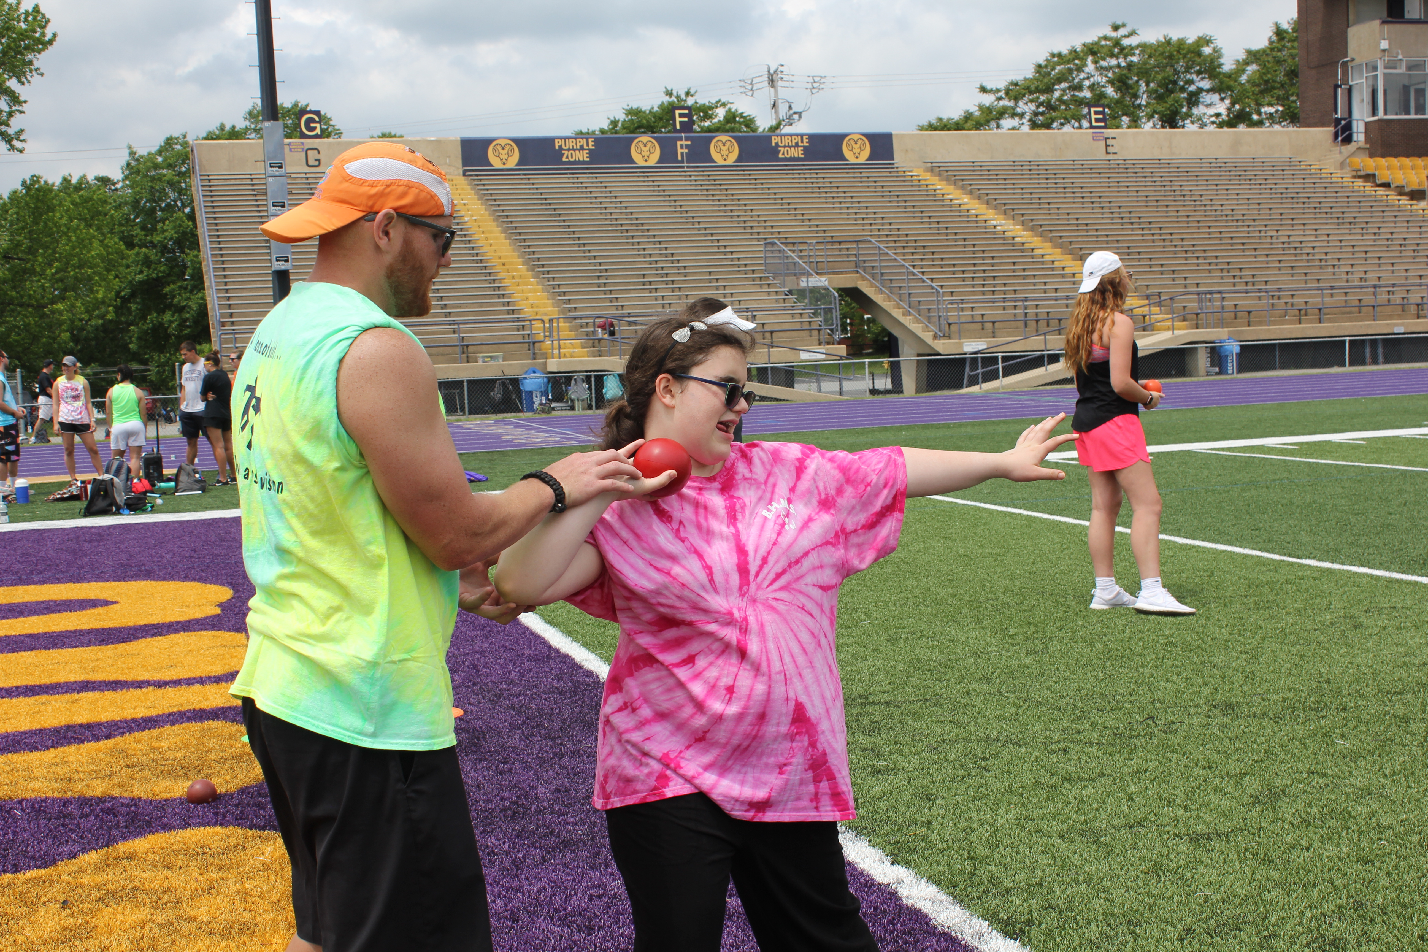
Physical Guidance
Teacher or peer tutor moves student through motion
Hand under hand
Notes:
Lauren

Slide 37
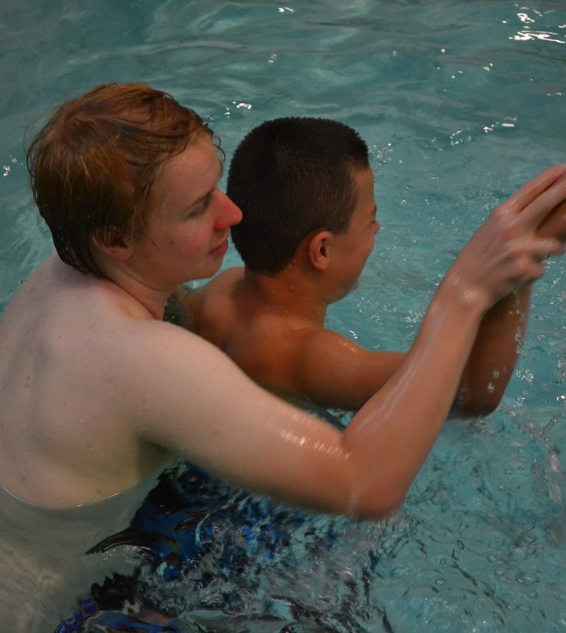
Co-active Movement
Teacher and student move through movement together
Notes:
Lauren

Slide 38
Guide-running
Guide running techniques
Guide wire
Tether
Human Guide
Independently
Treadmill
Notes:
Matt

Slide 39
Cross Country Running Video
http://www.campabilities.org/instructional-materials.html
Notes:
Matt

Slide 40
ACTIVITY TIME
Review Activities in Gym!
Notes:
Lauren

Slide 41
Multidisciplinary Team: Working Together
Need to share knowledge
Collaborate with each other
Train the Paraeducators and peer tutors
Notes:
Jasmine

Slide 42
Core Curriculum
The Existing Core Curriculum
English language arts other languages, to the extent possible
Mathematics science
Health and physical education
Fine arts social studies
Economics business education
Vocational education history
Notes:
Jasmine

Slide 43
Expanded Core Curriculum (ECC)
Compensatory or functional academic skills, including communication modes
Orientation and mobility
Social interaction skills
Independent living skills
Recreation and leisure skills
Career education
Use of assistive technology
Sensory efficiency skills
Self-determination
ECC video link here
Notes:
Lauren

Slide 44
ECC within Physical Education
Put a Smile :) next to items you are already doing
Put a Star next to items you believe you could implement
Think, Pair, Share: Develop one strategy for a component related to your position
Notes:
Lauren

Slide 45
Sports Involvement
Try outs-discuss modifications necessary
Provide equal opportunity for the students with VI with modifications or adaptations if necessary
Adaptations can not change the main objectives of the game
Examples: yellow softball
supporting swimmer on starting blocks
Guide runner in 1500
Caller in the 100
Tape around the volleyball
Call NY State HS Athletic Association and be sure they register your modification
Contact other coaches and referees in the league and let them know ahead of time.
Notes:
Matt

Slide 46
Self-Advocacy
What do we do at camp?
What do you do now for self-advocacy?
How can we continue self-advocacy?
Notes:
Matt

Slide 47
Camp Abilities
Notes:
Jasmine

Slide 48
Camp Abilities
Documentary
25th anniversary plans

Slide 49
5 Camp Abilities programs in NY State:
Saratoga
Brockport
Utica
Badger (Ithaca)
Long Island

Slide 50
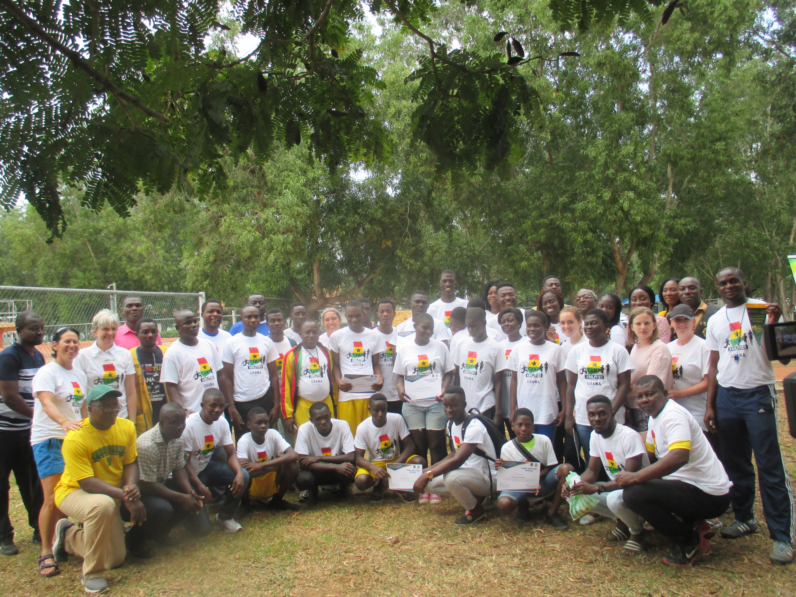
Camp Abilities Ghana

Slide 51
United States Association for Blind Athletes
Notes:
Lauren
5-a-side

Slide 52
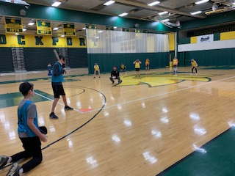
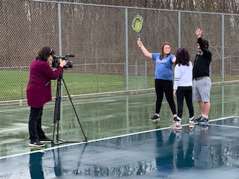
Inclusive Sports Video series
Cross Country (2017)
Track and Field (2017)
Swimming (2017)
Wrestling (2018)
Soccer (2018)
Basketball (2018)
Tennis (2019)
Beep baseball & kickball (2019)
Volleyball (2019)
www.campabilities.org under Instructional
Materials

Slide 53
Resources
www.aph.org/pe/products
www.campabilities.org
Books
Videos
Tip sheets
Power points
Checklists and assessments

Slide 54
Instructional web sites
Camp Abilities www.campabilities.org
Videos: “I Feel Included When”… video on Youtube
Inclusion series Instructional videos
USABA www.usaba.org
Texas School for the Blind (TSBVI.org)
APH.org
videos, books, products, curricula

Slide 55
Other equipment
www.glowproducts.com-everything that glows including frisbees
www.maxiaids.com-mini beeper
www.Independentliving.com-beeping volleyballs, basketballs, and soccer balls
www.exceptionalteaching.net-bell balls, sensory balls, beeping balls

Slide 56
Visual Impairments
In J.P. Winnick, & D. Porretta (2017) Adapted Physical Education and Sport Human Kinetics Publishers www.humankinetics.com
1-800-747-4457
Block, M.E. (Ed.)(2016). A Teachers Guide to Adapted Physical Education. Paul H. Brookes.

Slide 57
Routledge Handbook on Visual Impairment
https://play.google.com/store/books/details?id=8s5nDwAAQBAJ&gl=us&source=productsearch&utm_source=HA_Desktop_US&utm_medium=SEM&utm_campaign=PLA&pcampaignid=MKTAD0930BO1&gclid=CjwKCAjwv6blBRBzEiwAihbM-X6jjsqtIewDgByGedSAhrFP18HwVr3SOgPR8-MhTjr_hvIgQu-1zhoC9DgQAvD_BwE&gclsrc=aw.ds
One chapter on VI and PE and one on Deafblind and Physical activity

Slide 58
Physical Education and Sports for Individuals with VI or DB: Foundations of Instruction

Slide 59
Encyclopedia of Sports and Recreation for People with Visual Impairments
Andrew Leibs
Information Age Publishing
Sports and Recreation for people with VI from A-Z!

Slide 60
Run Play Move
Run, Play, Move: A planning model to create physical education activities for individuals with disabilities ($20.00 each)
Matt LaCortiglia
Perkins School for the Blind-Publications

Slide 61
“Everybody Plays”: How Children with Visual Impairments, Blindness or Deafblindness Play Sports
Elementary age children’s book
Profiles of 16 sports and recreation activities with interviews of children who do them
Forward by Erik Weihenmayer
Advice from Elite Athletes by:
Tricia Zorn-Swimming
Jim Mastro-Judo
Marla Runyan-Running
Jen Armbruster-Goal ball
APH.org

Slide 62
Everybody Plays

Slide 63
Other Books
Strategies for Inclusion
Universal Design for Physical Education
Case Studies in Adapted Physical Education

Slide 64
Questions

