Slide 1




2016 Camp Abilities
Family Advocacy Training
“A Loss of Sight, NEVER
A Loss of VISION”
By
Dr. Lauren Lieberman, Jessica Suppa and Micah Joseph

Slide 2
Overview
Physical Education
Instructional Strategies
Advocacy
IEP
Pre-teaching
Equipment
Sport Opportunities
Link for resources

Slide 3
Placement in Physical Education
What is their current placement?
  Modified Physical Education
  Self Contained
  Both?
Who determined this placement?
Were you included in this decision?
Who do you see if you are not satisfied?

Slide 4
PE Curriculum
What are your children learning?
  Should be learning the same curriculum as peers in GPE
  Learning a curriculum that accommodates their needs
Inclusion explained: Placement of students in the general mainstream classroom, where they are adequately participating in all lesson objectives or modifications to some objectives or tasks, but are primarily working alongside their peers without restriction.
What they like to learn?
  Your child should make suggestions on curriculum planning and delivery
  As the parent of the child you too have input on what you want the child to learn
    Adapted Physical Educator is most familiar and receptive to this concept.

Slide 5
Support Staff
Training for Teachers / Paraeducators
  https://www.youtube.com/watch?v=77fyMsRWrYs
Roles for both Peer Tutors / Para’s:
  Provide specific instruction
  Ensure safety
  Increase socialization & peer interaction
  Modify activities
  Assess and record data
  Motivate!
*Paraeducator provides input on IEP goals, objectives, and services

Slide 6
Advocacy
Physical Education Placement?
  Parent input first
  CSE Chair
Curriculum?
  PE / APE / PE Director / TVI / O&M/ Special Education Director
  Afterschool Sports?
    Athletic Directors, Coaches, PE teachers
  Equipment: School’s responsibility to provide
  After school sports (school sponsored)/home activity resources
    Lions Club, Rotary club

Slide 7

IEP
Is Physical Education on the IEP?
  Appropriate Goals / Objectives
    Relevant, useful, measurable
    Separate from OT/PT?
      Are they all the same, or different?
      If you want separate goals, you must request it

Slide 8
IEP Continued
IEP Development:
  PE, direct services, parents, CSE, teachers, child, related services, TVI, O&M
  Include: Equipment, Placement in PE, Support Staff, Time, Supplemental forms to define roles of PT, OT, etc.
  Collaboration with related service personnel
    Do all members of the IEP team meet on a regular basis?
Direct Services: provided directly to a child by a special education teacher or related services professional
Indirect services: a special education teacher or related service professional provides these services to others who are working directly with a child.
Related Services: OT/PT/Speech pathology/O&M/TVI
Exceptional Children’s Assistance Center IEP info

Slide 9
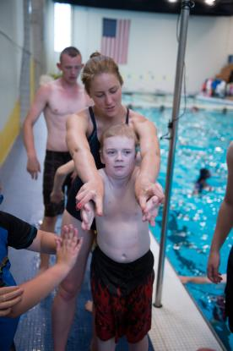
Instructional Strategies
Tactile Modeling: feels the instructor or peer go through the motions of a skill
Physical guidance: instructor guides the child through the motions of a skill
Co-Active Movement: Both the instructor and child perform the same movement at the same time together

Slide 10
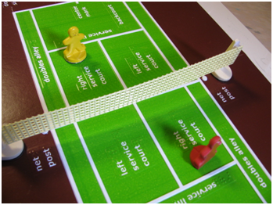
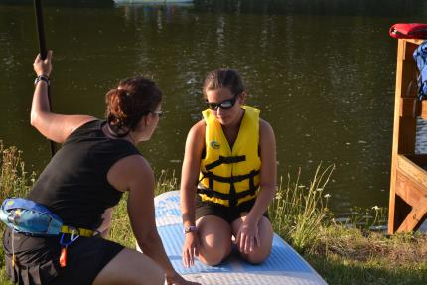
Pre-Teaching
Learning components:
  Equipment, rules, environment, (Tactile Boards)
  Positioning, Concepts, Scoring, Terms
  *** Teach prior to the unit for best results!

Slide 11
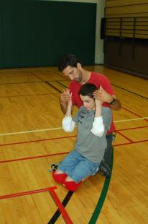
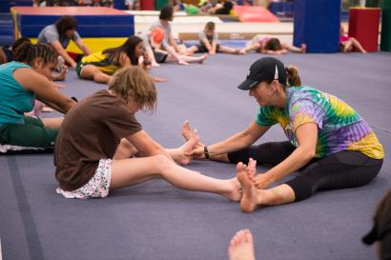
Pre-teaching continued
Athletes can participate in closed and open sports
    Open: offense and defense (Basketball, Soccer, Football, Volleyball)
    Closed: Environment is consistent (Shot-put, Archery, Golf, Gymnastics)

Slide 12
Whole – Part - Whole
The entire activity is presented first so that athletes understand what they are going to attempt to accomplish
The activity is then broken down into its component parts, which are taught and practiced
Finally, the athletes put the parts together into the whole activity or skill.
  Example 1: Use tactile boards prior to exploring the field of play or court
  Example 2: Show and explain equipment prior to teaching the unit

Slide 13
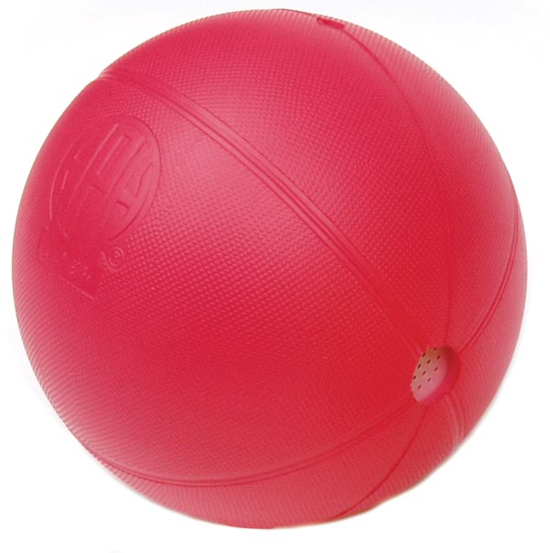


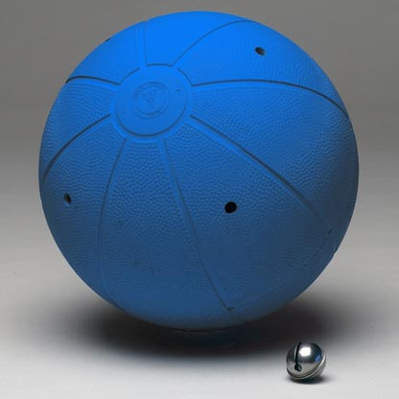
Equipment
Beeping Ball
Bell Ball
Resources for:
  Beep baseball
    http://www.nbba.org/equipment.htm
  Beep kickball
    http://www.beepkickball.com
  Goalball
    ABVI Goalball kit
    Targe
  Soccer
    ISA Soccerball with Rattle Pods recommended
  Football 5-A-Side
    IBSA futsol Blind Soccer ball
  Basketball
    Ringing Basketball

Slide 14
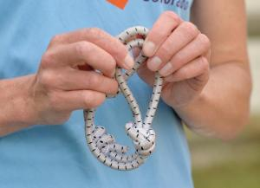
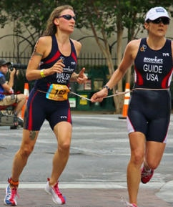
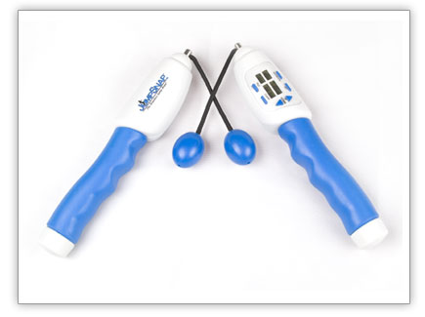
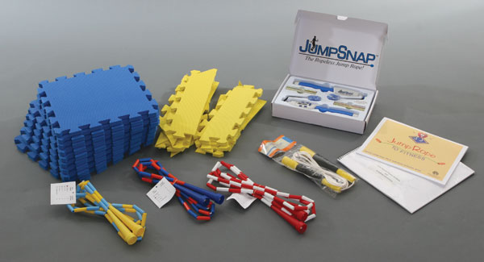
Equipment Continued
Running equipment
  Tethers (hip, string, loops)
Jump Rope Kit & Walk-Run For Fitness
  American Printing House For The Blind

Slide 15
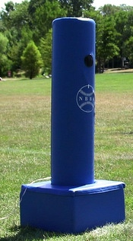
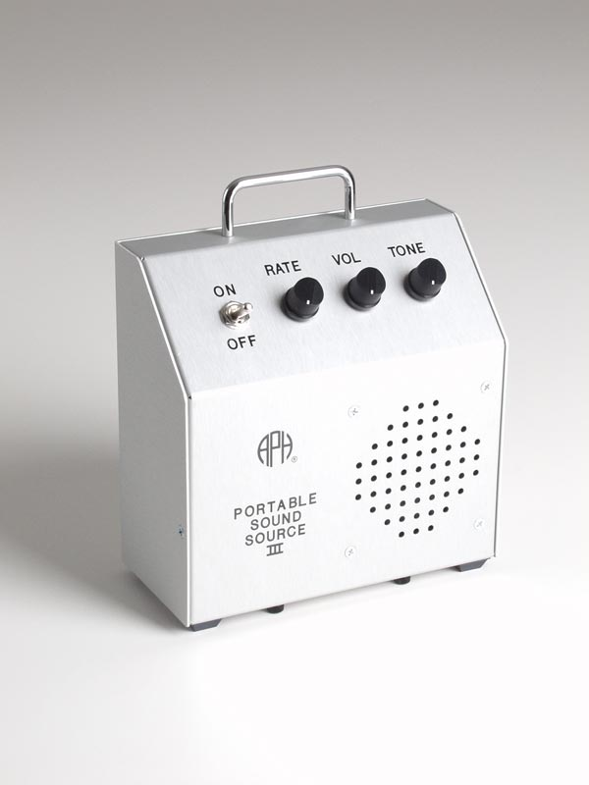
Equipment Continued
Buzzing equipment
Beeping equipment
  Beeping eggs
  Sound boxes

Slide 16

FUNDING for Equipment
Committee for Special Education
Quota Funds
Writing on the IEP
  Modifications
Challenged Athletes Foundation
Community Organization Donors
State instructional technology center (can borrow for 2 weeks and can apply for an extension)
    parents can borrow equipment
    can also purchase second hand technology
    more recreational items
Athletic development accounts through USABA
  Can donate money to kids for travel competition expenses etc.
  get a letter to use for tax deduction
Leveling The Playing Field

Slide 17
How To Make Your Own Equipment
Glow / Illuminating products
Add grocery bag to outside of a ball
Add rice or bells to a beach ball/soccerball
3d Printer
  ***Raising children can be very expensive. It must be understood that this equipment may not always come donated it will be a cost to families occasionally.***

Slide 18
Sport Opportunities
Afterschool Sports
USABA
  Gateway To Gold (Pipeline for Paralympics)
Community Sports
Recreational
    Biking, Fishing, Kayaking, Hiking, Rollerblading, Stand-up paddle boarding,
Empire State Games For The Physically Challenged
  Brockport, NY
  Long Island (Nassau County)
Victory Challenge (Physical Disabilities)
  Long Island
Special Olympics vs. Paralympics
  Pathways to Paralympics

Slide 19
Paralympic Sports
Goalball
Swimming
Track & Field
Archery
XC Skiing
Alpine Skiing
Tandem Cycling
Equestrian
Judo
Para Triathlon
Rowing
Sailing
Biathlon
Futbal 5-A-Side

Slide 20
Steps to After School Sport Involvement
Talk to the coach before try-outs
Obtain permission from physician and give to coach
Discuss any modifications or adaptations ahead of time with the coach
Share modifications and adaptations with the High School Athletic Association & other coaches and officials
Do a disability awareness program with teammates so they know what is needed and helpful tips

Slide 21
Steps To After School Sport Involvement Continued…
Paralympics has a committee that works with highschool associations in order to make sports inclusive
Dear Colleague Letter
Adaptations/Modifications
  Athletics For All
  USABA Mobile Coach

Slide 22
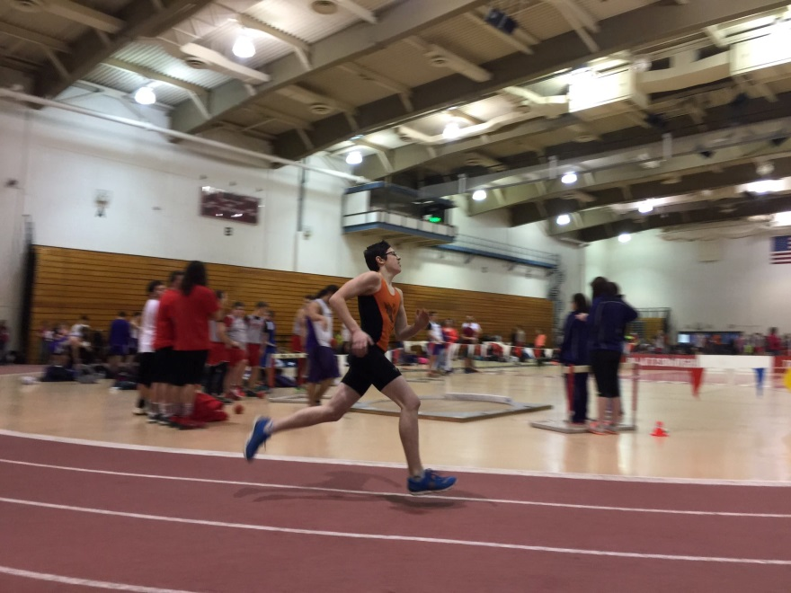
Sport Involvement of Camp Abilities Athletes
Angela King, proud mother of Logan King, wrote to tell us that Logan, after attending Camp at Brockport twice, and here in Saratoga last summer, has joined the Plattsburgh High School track team as a Freshman and is having notable and impressive success as a runner. According to Angela, he has been placing 2nd or 3rd in ALL of his races and, this past Saturday, he took first in the 300m dash, with a time of 47 secs! "Due to his attending your camp, he found out he was good at track... I can't thank you and your amazing staff enough for helping Logan to gain confidence and experience things he might not have tried on his own.”

Slide 23
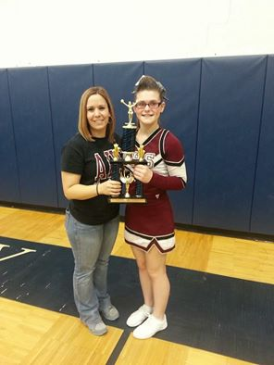
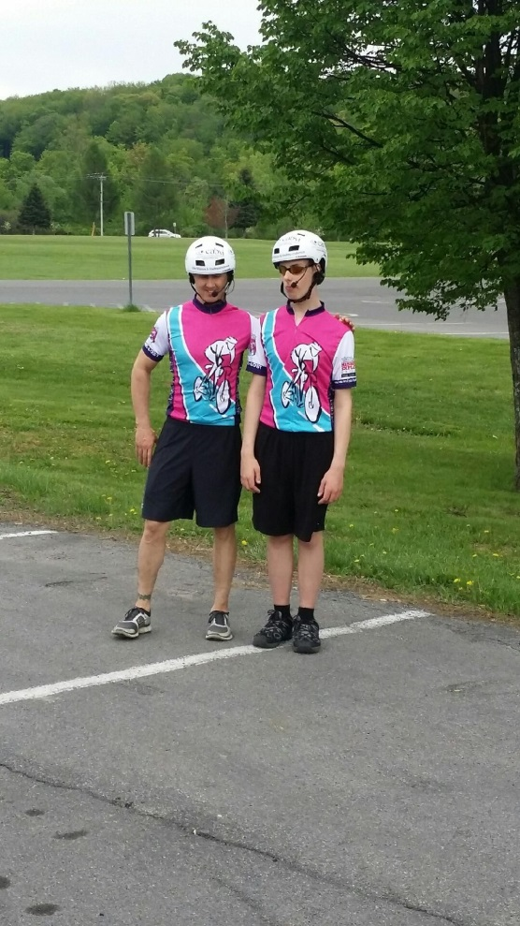
Sport Involvement of Camp Abilities Athletes
Jessica has been a cheerleader since she was 5. She is now 13 and she still loves it! Thank you! - Mom
Here is Quinton (right) pictured participating in a bike race for Missing Children.

Slide 24
Contacts for Consultation
Dr. Lauren Lieberman: llieberm@brockport.edu
Kathy Beaver: kathyb@cabvi.org
Kelsey Linsenbigler: klins1@u.brockport.edu
Alex Stribing: astri1@u.brockport.edu
Lisa Santos: campabilitieslongisland@yahoo.com
Tiffany Mitrakos: tmitr1@u.brockport.edu

Slide 25
General Helpful Links
Instructional Support
  campabilities.org
  Perkinslearning.org
  http://www.teachingvisuallyimpaired.com/physical-education.html-
  Tsbvi.edu
  ECAC Parent Training Info.
  USABA.org
Equipment:
  American Printing House For The Blind
  US Games
  Flaghouse
  The Braille Superstore
Guide running:
  http://www.achillestrackclub.org/
  USABA Basics of Guide Running for Track & Field and Trail
Travel/Equipment Funding
  Challenged athletes foundation
  Leveling The Playing Field

